Slide 1

USER MANUAL
LOLMOVIES.com
LOLMOVIES.com
The Best Comedy movies.
DBMS Final Assignment | Michal Berkheim, Michal Lahav, Reshit Carmel | 2025

Slide 2

LOLMOVIES.com Overview
LOLMovies.com is a web application designed to make the world’s best comedy movies easily accessible to anyone looking for a good laugh.
In times of uncertainty, when many of us are facing the challenges of war and Miluim, we believe that laughter is more important than ever — it provides a much-needed escape and a moment of relief.
The application provides access to detailed information about the top 1,000 highest-rated, full-length comedy movies of all time in the U.S. (English-language), sorted by popularity in descending order.
Key Features:
Advanced Search: Find movies by keywords or by searching for words that appear in the title or overview.
Actor & Director Insights: Explore a director’s favorite collaborators, or find the top 10 actors who starred in the most films within a specific subgenre and decade.
Hidden Gems: For cinephiles seeking originality, this feature highlights underrated yet highly rated movies from a given year.
Popular Picks: Search for a director or actor's most popular movies or explore the most popular genres of a specific actor.
Our application is designed for both casual viewers and dedicated movie enthusiasts, ensuring that everyone can find the perfect comedy to bring a smile, even in difficult times.

Slide 3




LOLMOVIES.com Main Webpage

Slide 4





LOLMOVIES.com Q1: FULLTEXT Search – Title\Overview
⌕ space
Title: Paul
Genres: Adventure, Comedy, Science Fiction
Release Year: 2011
Overview: For the past 60 years, a space-traveling smart...
Rating: 6.727
“space” in title
“space” in overview

Slide 5




LOLMOVIES.com Q2: FULLTEXT Search – keyword
⌕ witch
Title: Hotel Transylvania 2
Release Year: 2015
Director: Genndy Tartakovsky
Overview: When the old-old-old-fashioned vampire Vlad ar... Rating: 6.800

Slide 6
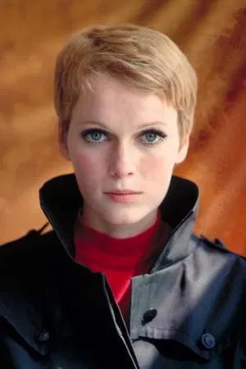


LOLMOVIES.com Q3: Director's favorite collaborators
⌕ Woody Allen
Mia Farrow
Movie Count: 4

Slide 7
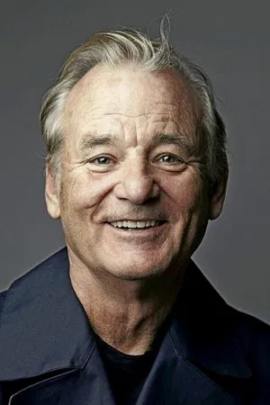

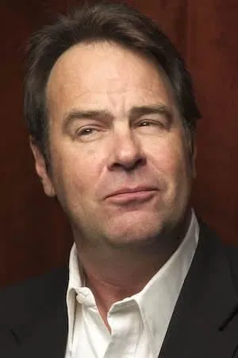
LOLMOVIES.com Q4: Hall of Fame
⌕ 1980, fantasy
Michelle Pfeiffer
Birthday: 1958-04-29
Movie Count: 2

Slide 8




LOLMOVIES.com Q5: Hidden Gems
⌕ 2012
Title: Pitch Perfect
Overview: College student Beca knows she does not want t...
Rating: 7.290
Popularity: 32.496

